Slide 1


Generative AI
Full Stack Developer
01

Slide 2
Course A : Prompt Engineering
05

Slide 3
03
LLM Programing & Best Practices
05
Notes:
Hello everyone, welcome to this session on Prompt Engineering 101. My name is [Your Name] and over the next two hours, we’re going to dive deep into how we can craft effective prompts for Large Language Models like ChatGPT, Claude, and Gemini. We’ll not only learn the concepts but also do live demonstrations so you can see the impact of good prompt design in real-time. By the end of this session, you’ll have a toolkit of patterns and techniques you can start using immediately.

Slide 4



Introduction & Objectives
Session Focus:
LLM programming best practices (quality, reliability), prompt design and tuning, model selection, API usage,
performance/cost optimization.
Audience:
Finance, Customer Service, and IT professionals looking to leverage LLMs effectively.
Guiding Principles:
Clear instructions, iterative testing, and domain-specific adaptation for better outcomes.
Notes:
Prompt engineering is essentially the art and science of crafting the right inputs so that an AI model can give you the most accurate, useful, and contextually relevant output. Think of it as giving instructions to a very literal but very capable assistant. If your instructions are clear and well-structured, the results will be better. A simple analogy is that a prompt is like an instruction sheet for a human worker — the clearer the sheet, the better the work.

Slide 5


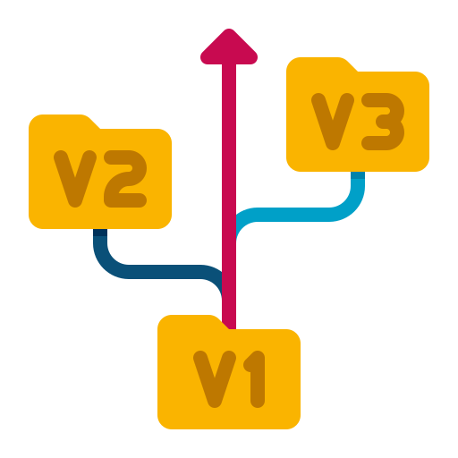




Best Practices: Quality & Reliability
Monitoring & Logging
Track API usage, tokens, latency, and errors.
Error Handling
Retries with exponential backoff, fallback logic.
Model Versioning
Pin to exact versions, test updates in staging.
Input Validation
Track API usage, tokens, latency, and errors.Sanitize and validate prompts before sending.
Security
Mask PII, store API keys securely.
Cost Control
Cache frequent queries, use smaller models when possible.
Implementing these practices ensures reliable and cost-effective LLM integration.
Notes:
Prompt engineering is essentially the art and science of crafting the right inputs so that an AI model can give you the most accurate, useful, and contextually relevant output. Think of it as giving instructions to a very literal but very capable assistant. If your instructions are clear and well-structured, the results will be better. A simple analogy is that a prompt is like an instruction sheet for a human worker — the clearer the sheet, the better the work.

Slide 6



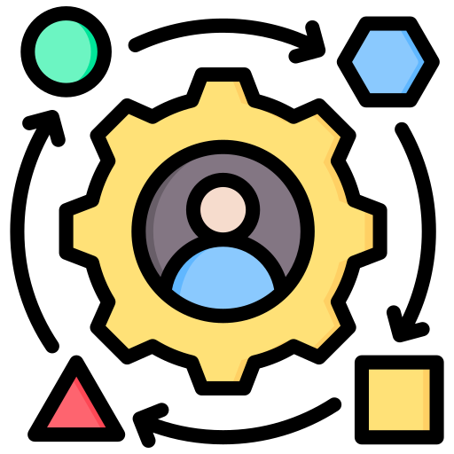
Choosing: Right Model
Latest & Most Capable
Use the latest, most capable models for complex tasks
Speed vs. Quality
Balance speed vs. quality — smaller models for simple
tasks.
Specialized Models
Consider specialized or modality-specific models when available.
Context & Capabilities
Check context window size, capabilities, and vendor
updates.
Match model capabilities to your specific
task requirements for optimal results.
Notes:
Prompt engineering is essentially the art and science of crafting the right inputs so that an AI model can give you the most accurate, useful, and contextually relevant output. Think of it as giving instructions to a very literal but very capable assistant. If your instructions are clear and well-structured, the results will be better. A simple analogy is that a prompt is like an instruction sheet for a human worker — the clearer the sheet, the better the work.

Slide 7
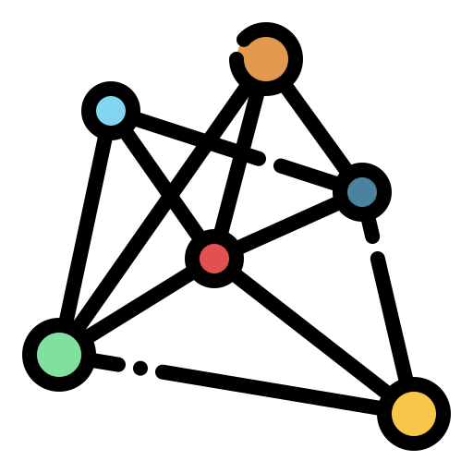




Configuring: Model Parameters
Model
Always specify exact model version.
Temperature
Low = deterministic high = creative.
Max Tokens
Set output length limits.
Other Params
top_p, penalties to avoid repetition.
Roles
Use system for global rules, user for specific queries.
Carefully configuring these parameters will significantly impact response quality and consistency.
Notes:
Prompt engineering is essentially the art and science of crafting the right inputs so that an AI model can give you the most accurate, useful, and contextually relevant output. Think of it as giving instructions to a very literal but very capable assistant. If your instructions are clear and well-structured, the results will be better. A simple analogy is that a prompt is like an instruction sheet for a human worker — the clearer the sheet, the better the work.

Slide 8
Practice: Crafting a Clear Prompt
Task Improve the following basic prompt:
Example Improvement
Explain quantum computing.
Before
"Summarize the text below."
Goal:
Make it clear, specific, and structured.
After
Add output format, length, and audience.

Slide 9
Practice: Crafting a Clear Prompt
Task Improve the following basic prompt:
Example Improvement
Explain quantum computing.
Before
"Summarize the text below."
Goal:
Make it clear, specific, and structured.
After
Add output format, length, and audience.
"Summarize the text below in 3-4 sentences. Focus on the key
technical concepts and write it for a non-technical audience."

Slide 10






Prompt: Tuning Techniques
Iterative Prompting
Start simple, add examples if needed.
Clarity & Detail
Include purpose, audience, constraints.
Explicit Instructions
Use specific numbers, avoid vague terms.
Examples & Templates
Show desired output format.
Role Assignment
Influence style/tone with role-based prompts.
Step-by-Step Reasoning
For complex logic tasks.
Experiment with different techniques and combinations to find what works best for your specific use case.
Notes:
Prompt engineering is essentially the art and science of crafting the right inputs so that an AI model can give you the most accurate, useful, and contextually relevant output. Think of it as giving instructions to a very literal but very capable assistant. If your instructions are clear and well-structured, the results will be better. A simple analogy is that a prompt is like an instruction sheet for a human worker — the clearer the sheet, the better the work.

Slide 11




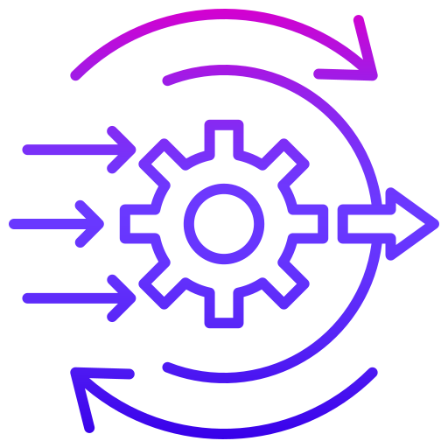
Evaluating Performance
Metrics
Define measurable success (accuracy, completion rate).
Quantitative Testing
Test sets, A/B testing.
Qualitative Review
Check coherence, relevance, factuality.
Edge Cases
Test for unusual or malicious inputs.
Iteration
Use feedback to refine prompts.
Systematic evaluation enables continuous improvement and helps build reliable LLM applications.
Notes:
Prompt engineering is essentially the art and science of crafting the right inputs so that an AI model can give you the most accurate, useful, and contextually relevant output. Think of it as giving instructions to a very literal but very capable assistant. If your instructions are clear and well-structured, the results will be better. A simple analogy is that a prompt is like an instruction sheet for a human worker — the clearer the sheet, the better the work.

Slide 12


Iteration & Tuning
Prompt Refinement
Remove ambiguity, tighten scope.
Parameter Adjustments
Tweak temperature, token limits.
Cost vs. Quality
Use smallest acceptable model;
Fine-tune only if needed.
Few-Shot Changes
Vary examples to guide style.
Iterative improvement is key to optimizing LLM performance. Start simple, test often, refine systematically.
Notes:
Prompt engineering is essentially the art and science of crafting the right inputs so that an AI model can give you the most accurate, useful, and contextually relevant output. Think of it as giving instructions to a very literal but very capable assistant. If your instructions are clear and well-structured, the results will be better. A simple analogy is that a prompt is like an instruction sheet for a human worker — the clearer the sheet, the better the work.

Slide 13





Prompt Cost & Token Optimization
Shorten Prompts
Shorten prompts without losing meaning.
Limit Output
Limit output via instructions or token caps.
Batch Queries
Batch queries where possible.
Caching
Cache repeated queries and results.
Monitor Usage
Monitor token usage and summarize context.
Effective token optimization significantly reduces costs while maintaining output quality.
Notes:
Prompt engineering is essentially the art and science of crafting the right inputs so that an AI model can give you the most accurate, useful, and contextually relevant output. Think of it as giving instructions to a very literal but very capable assistant. If your instructions are clear and well-structured, the results will be better. A simple analogy is that a prompt is like an instruction sheet for a human worker — the clearer the sheet, the better the work.

Slide 14
Practice: Token & Cost Optimization
Task Improve the following basic prompt:
Example Improvement
"Please provide a concise summary of the following customer feedback. The summary should only include the most important points and should not exceed a few sentences."
Before
"Please provide a concise summary of the following customer
feedback. The summary should only include the most important
points and should not exceed a few sentences."
Goal:
Reduce tokens while keeping intent.
After
Use bullet limits, remove fluff, be precise.

Slide 15
Practice: Token & Cost Optimization
Task Improve the following basic prompt:
Example Improvement
"Please provide a concise summary of the following customer feedback. The summary should only include the most important points and should not exceed a few sentences."
Before
"Please provide a concise summary of the following customer
feedback. The summary should only include the most important
points and should not exceed a few sentences."
Goal:
Reduce tokens while keeping intent.
After
"Summarize key points from this feedback in 3 bullet points."
Use bullet limits, remove fluff, be precise.

Slide 16




Summary & Next Steps
Clear instructions + examples = better results
Well-structured prompts with explicit guidance produce more accurate outputs.
Monitor performance, cost, and reliability
Track key metrics to ensure efficiency and identify opportunities for improvement..
Optimize tokens and choose models strategically
Balance capability needs with cost considerations when selecting and using LLMs.
Practice, iterate, and keep up with vendor updates
Continuous improvement cycle ensures you leverage the latest capabilities.
Notes:
Prompt engineering is essentially the art and science of crafting the right inputs so that an AI model can give you the most accurate, useful, and contextually relevant output. Think of it as giving instructions to a very literal but very capable assistant. If your instructions are clear and well-structured, the results will be better. A simple analogy is that a prompt is like an instruction sheet for a human worker — the clearer the sheet, the better the work.

Slide 17
Q / A

Slide 18
Thanks

